Slide 1

Mini Project- Animated Movies
Thomas Sniezek

Slide 2
Data Tractability
From Kaggle- 52,000 Animated Movies
Scraped from TMDB API (The Movie Database)

Slide 3
Research Questions
Originally- "What factors significantly contribute to the generation of the highest revenue in the animated movie industry?"
After further research into the dataset, a better question that could be asked is "What genres significantly contribute to the generation of the highest revenue in the animated movie industry"

Slide 4
Data
From 52,000 --> 647 observations
Took out all movies with revenue =0 and budget =0
Added a binary 1 or 0 for if there was another movie released within 30 days before or after the previous movie
Added a binary variable 1 or 0 if the movie won an animated Movie of the Year Award
Make a binary variable if the movie was classified in a certain genre or not for the top 10 most popular genres in the dataset Ex. Fantasy Drama Action

Slide 5
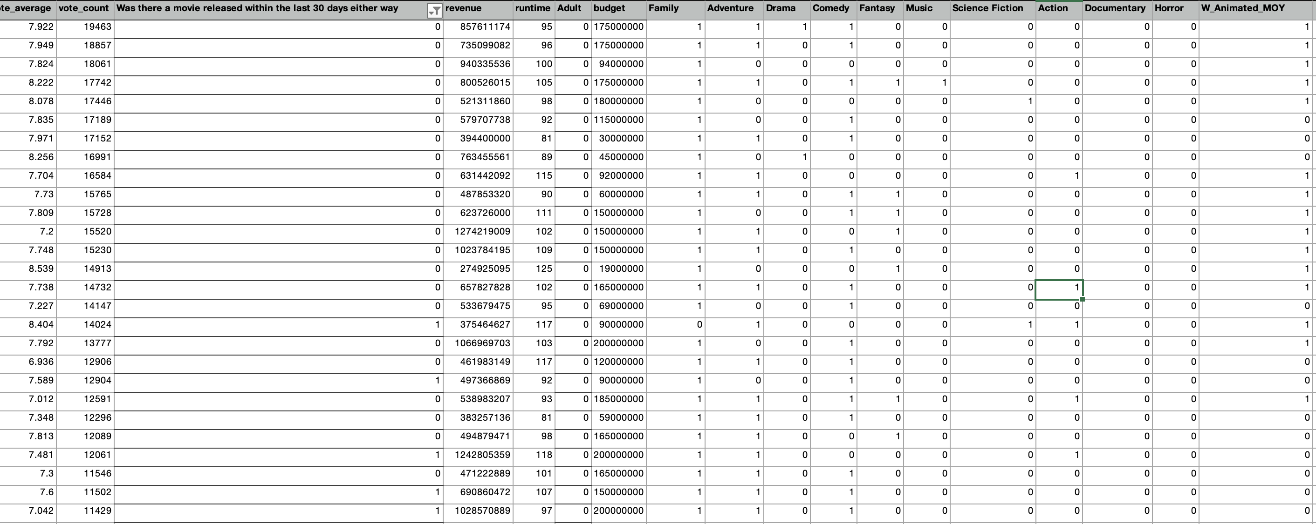

Slide 6
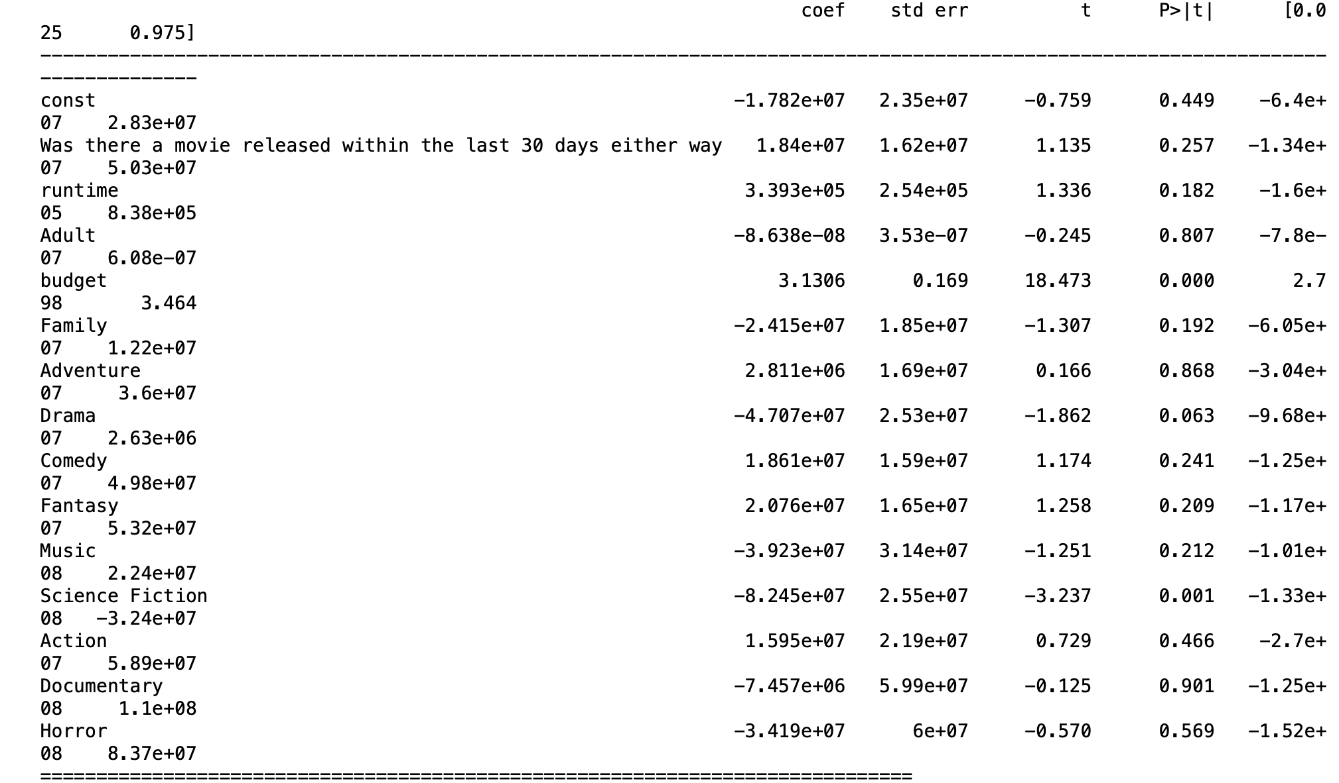
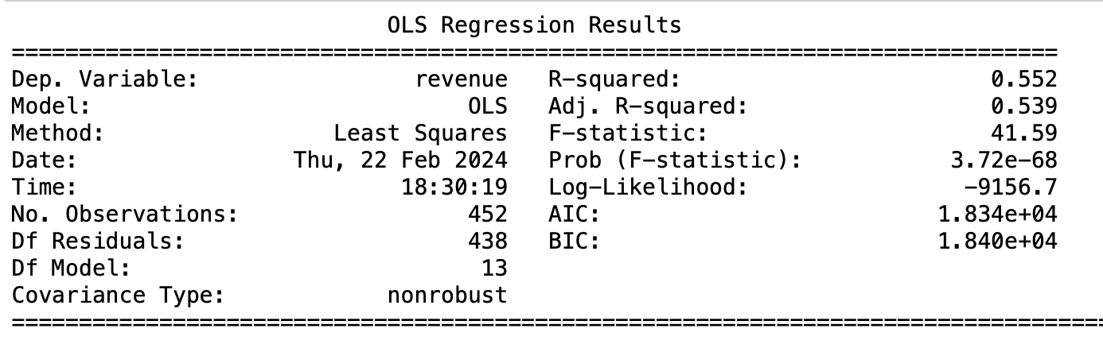
Exploratory Data Analysis
This uses only statistics that the producer can control

Slide 7
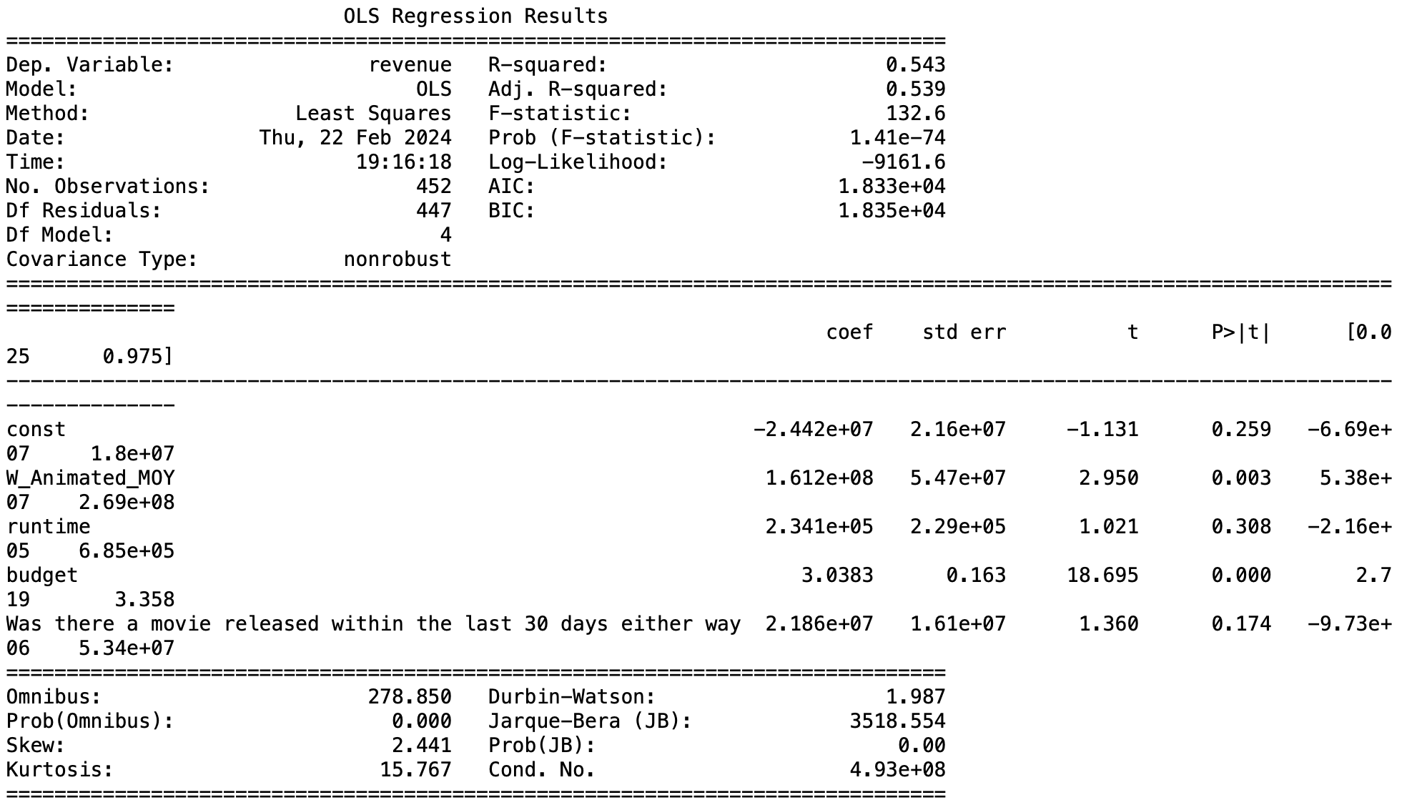
Exploratory Data Analysis
Everything controllable besides genre

Slide 8
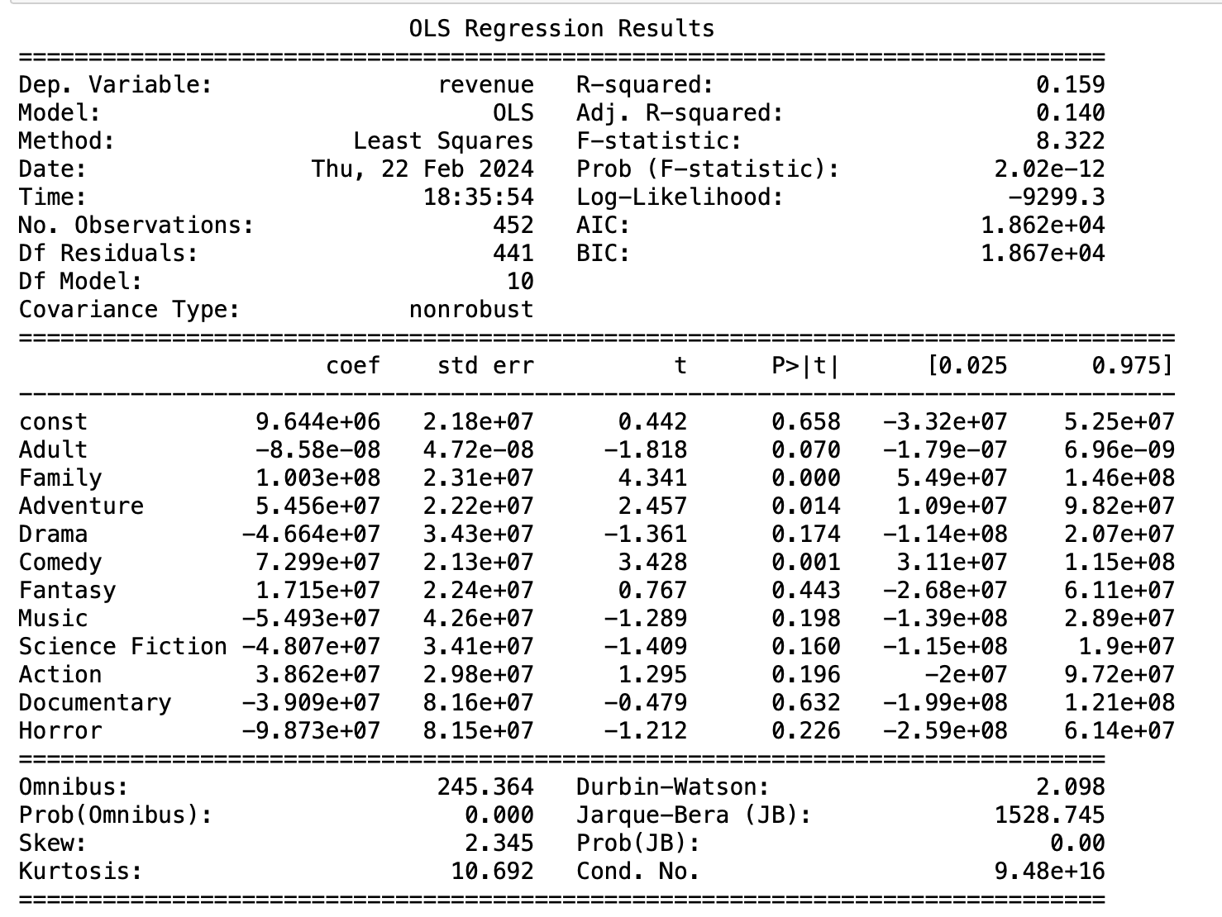
Exploratory Data Analysis
Only Genres

Slide 9
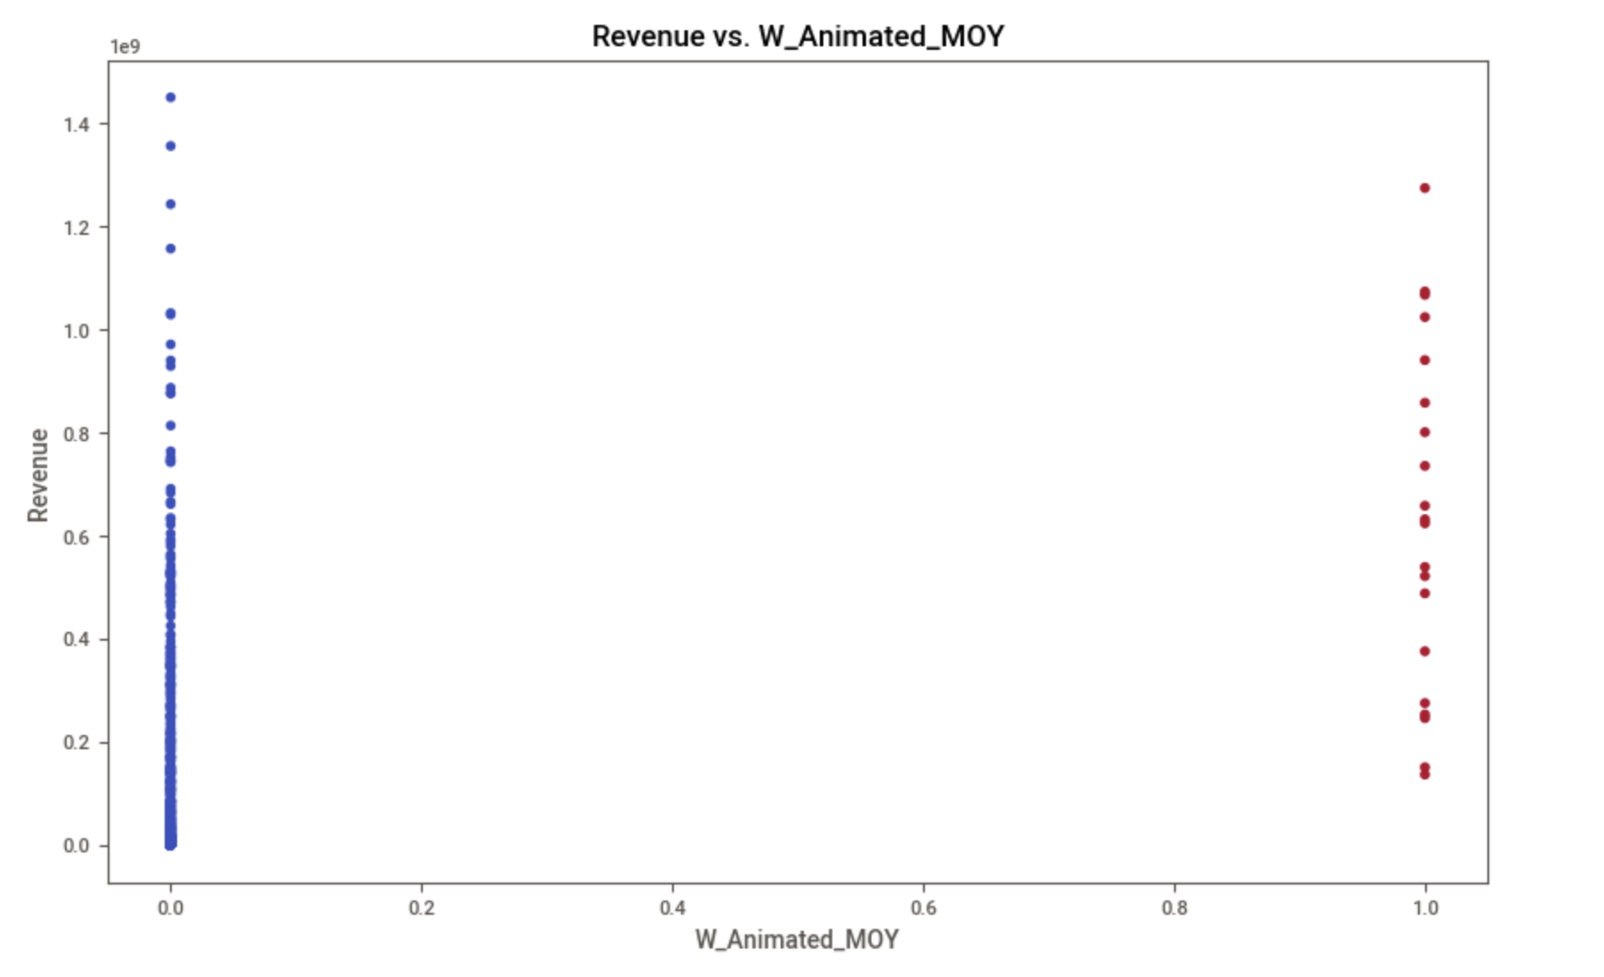
Exploratory Data Analysis
Revenue is in Billions
Red dots won an animated Movie of the Year

Slide 10
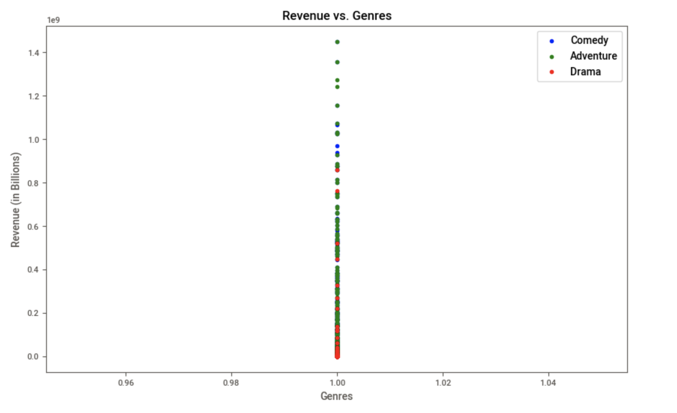
Exploratory Data Analysis
Revenues for the Top 3 Genres

Slide 11
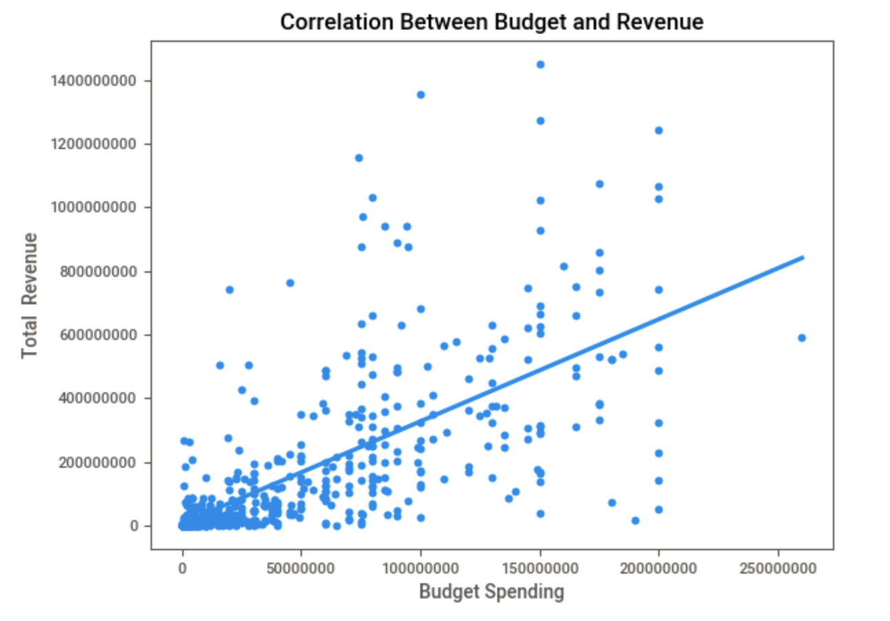
Is There a Correlation Between Budget and Revenue?

Slide 12
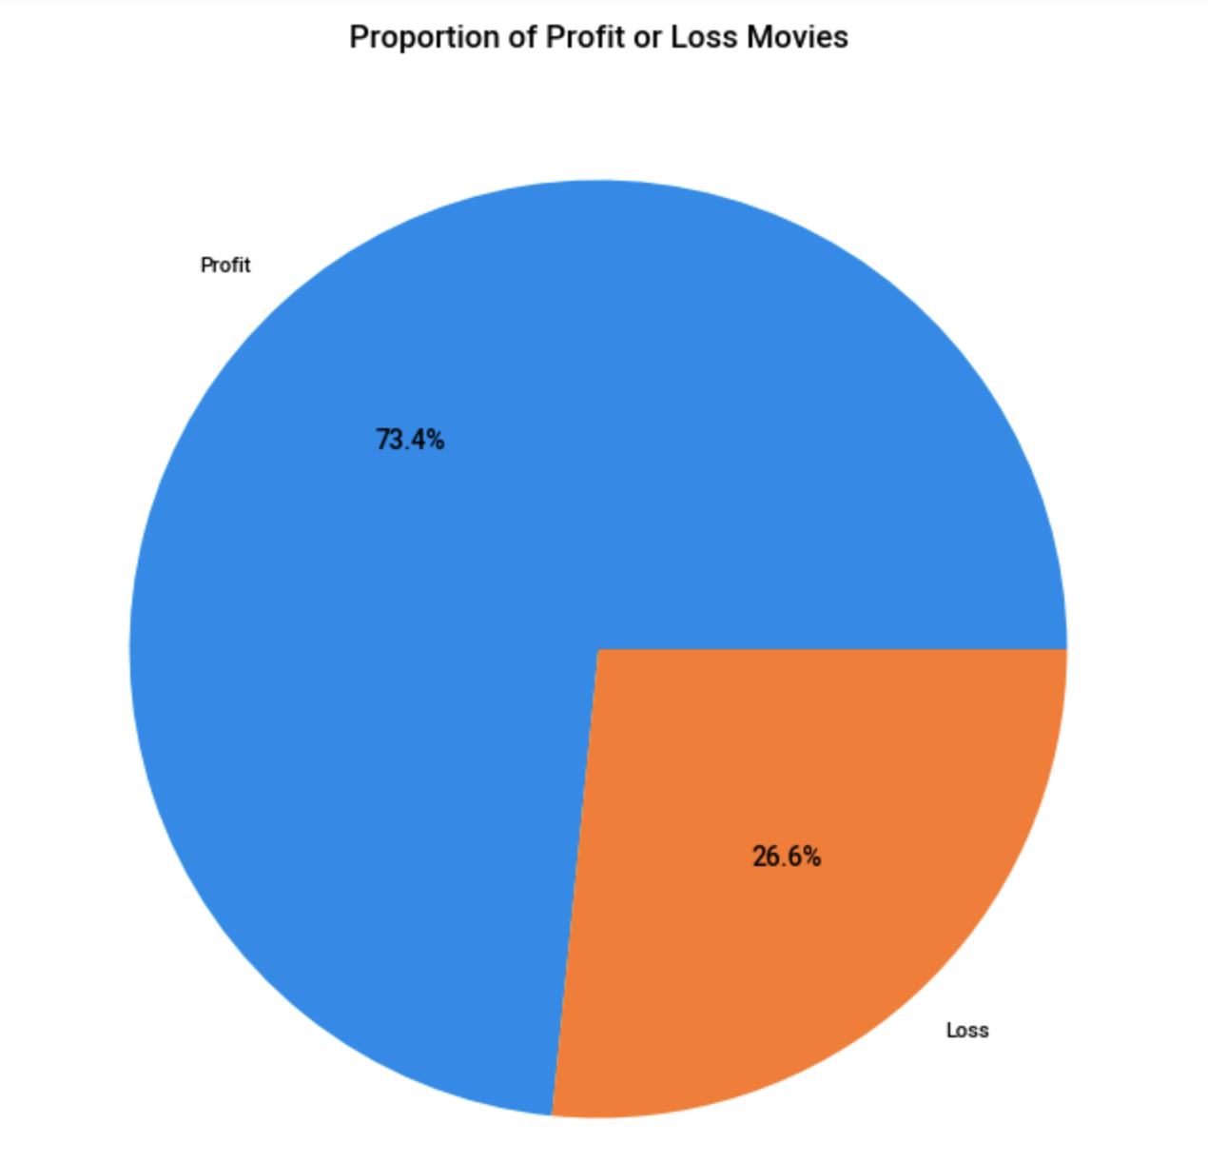
Do Most Animated Movies Profit or Loss?

Slide 13
Stakeholder Implications
Majority of the stakeholders in this case are the producers/production companies and writers
Writers may want to write more about action as there are more action animated films with higher revenue and they may get a larger amount of compensation
Production companies may want to only produce movies that are intended for a certain audience as they bring in the most revenue
Production companies may be willing to give writers a larger budget to create the films as it appears there is a positive correlation with revenue and budget

Slide 14
Ethical, Legal, Societal Implications
With more research into this topic, perhaps a way to create more revenue could be found which could create copyright disputes, intellectual property disputes or potential changes in copyright laws may occur to address this new method. As everyone may want to create the same type of movie
With more research into this topic, it could lead to insights on the economic impact of the animated movie industry, including job creation, revenue distribution, and economic contributions to local communities especially where a movie is shot.
If we were to continue this research and dive deeper into the animated movie industry, we would need to ensure that the research does not contribute to any underrepresentation or feed into any stereotypes regarding animated movies, production companies or actors.

